Slide 2
Lecture 5: Consumer Choice: Individual and Market Demand

Slide 3
Consumer Choice Theory and Utility Maximization
Consumer choice theory explains how consumers make decisions based on their preferences and budget constraints.
Utility maximization is the core principle, where consumers seek to maximize their satisfaction or utility from the goods and services they consume.

Slide 4
Indifference Curves and Budget Constraints
Indifference curves represent combinations of goods that provide the same level of satisfaction to consumers.
Budget constraints depict the limits on consumer choices due to their income and the prices of goods and services.

Slide 5
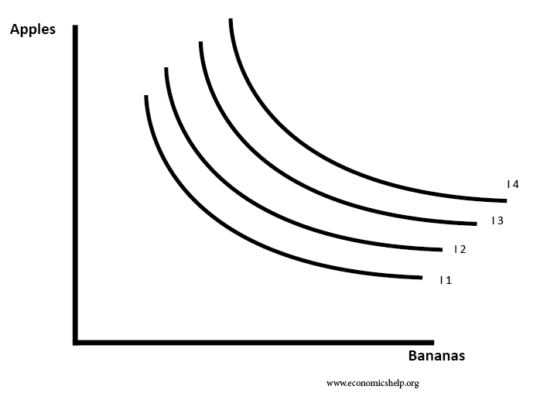
Indifference Map

Slide 6
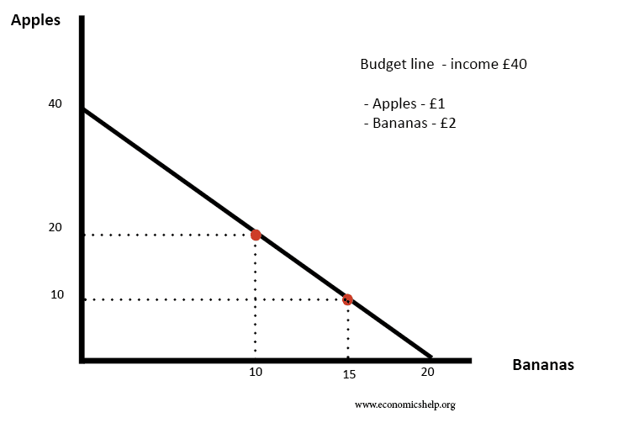
Budget constraint

Slide 7
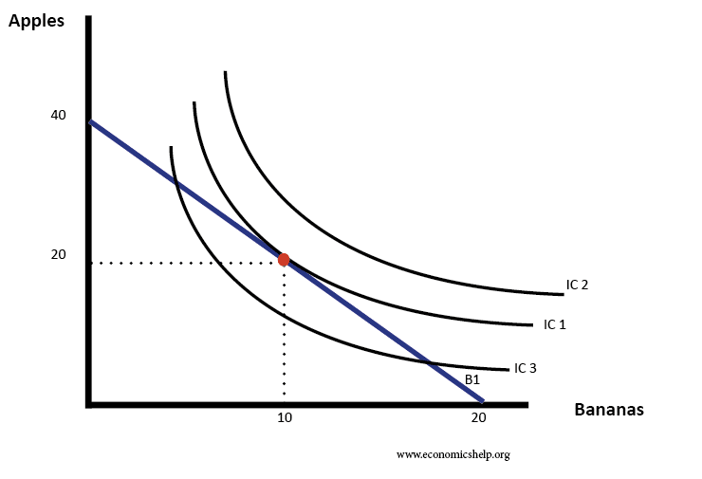
Indifference Map and Budget constraint

Slide 8
Individual Demand Curve
Individual demand curves show the quantity of a good a single consumer is willing to buy at different price levels, while keeping other factors constant.
We derive individual demand curves from utility-maximizing choices by analyzing the combinations of goods that maximize satisfaction within the budget constraint.

Slide 9
Market Demand Curve
Market demand curves represent the total quantity of a good that all consumers in the market are willing to buy at various price levels.
Market demand curves are obtained by horizontally summing the individual demand curves of all consumers in the market.

Slide 10
Application in Value Chain Agriculture
In value chain agriculture, consumer choice theory is applied to analyze the demand for different agricultural products.
Understanding consumer preferences and their response to price changes helps value chain actors make informed production and marketing decisions.

Slide 11
Exercises: Drawing Indifference Curves, Deriving Individual Demand Curve, and Deriving Market Demand

Slide 12
Consider the following utility function for a consumer, where X represents quantity of good X and Y represents quantity of good Y:
Utility function: U(X, Y) = X^{0.5} * Y^{0.5}

Slide 13
Exercise Drawing Indifference Curves
a) Plot the indifference curves for the utility levels U = 1, U = 4, and U = 9 on the same graph.
Derive Individual Demand Curve
The consumer's budget constraint is given by: P_{X} * X + P_{Y} * Y = M,
where: P_{X} is the price of good X,
P_{Y} is the price of good Y,
M is the consumer's income.
Assume P_{X} = 4, P_{Y} = 2, and M = 16.
i) Calculate the consumer's budget line equation.
ii) Plot the budget line on the graph with indifference curves from Part 1.
iii) Determine the optimal bundle (X, Y) that maximizes the consumer's utility, given the budget constraint.

Slide 14
Deriving Market Demand
Suppose there are two consumers in the market with the following utility functions:
Consumer 1: U(X, Y) = X^{0.5} * Y^{0.5}
Consumer 2: U(X, Y) = 2X^{0.5} * Y^{0.5}
The market prices are P_{X} = 4 and P_{Y} = 2, and both consumers have an income of M = 16.
i) Derive the individual demand for good X and good Y for each consumer.
ii) Calculate the total market demand for good X and good Y.

Slide 15
Understanding consumer choice theory and individual and market demand is vital VCA students as it enables them to predict market demand, analyze purchasing behavior, and make informed decisions in the agricultural sector.
By grasping these concepts, students will be better equipped to contribute to the efficiency and sustainability of value chain agriculture.

